Slide 1
Low-Cost Real-Time Water Depth Measurement System
Project Proposal
Bienvenido Hiyas Jr.
James Cook University
Supervisor: Tao Huang (Kevin)

Slide 2
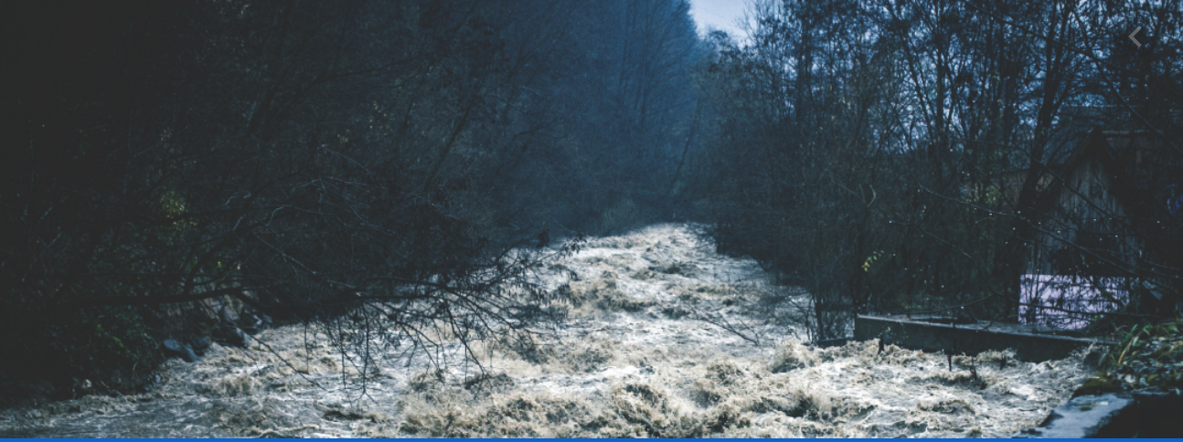
Introduction
Water Depth is one of the essential parameters in environmental monitoring.
Real-Time Water Level Monitoring is vital during wet season.
Conventional Sensors (Float, Radar or ultrasonic, pressure transducer)
https://www.optex.co.jp/e/solutions/river-monitoring.html

Slide 3
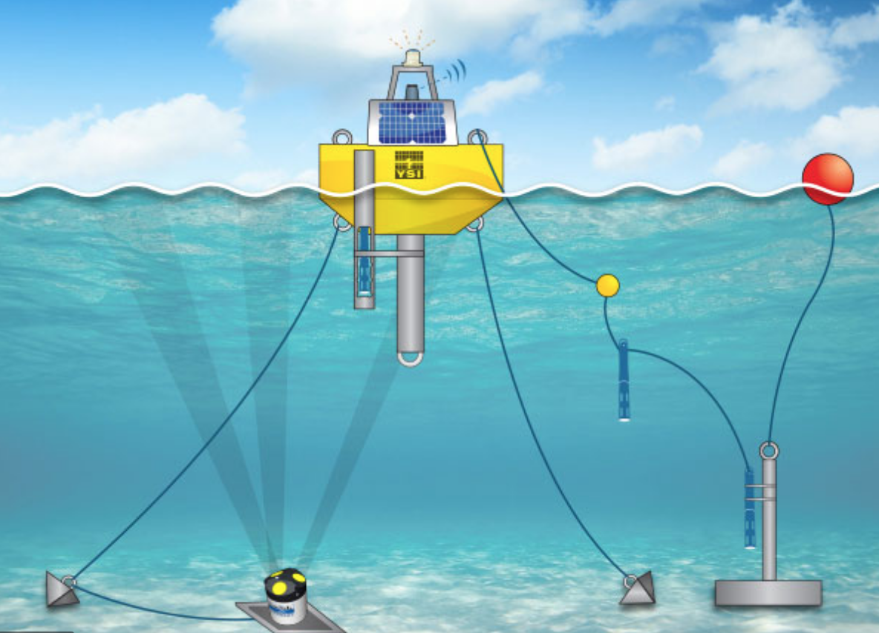
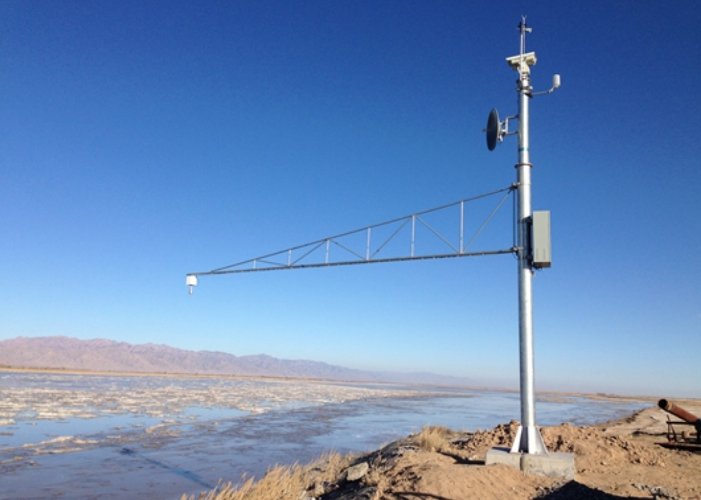
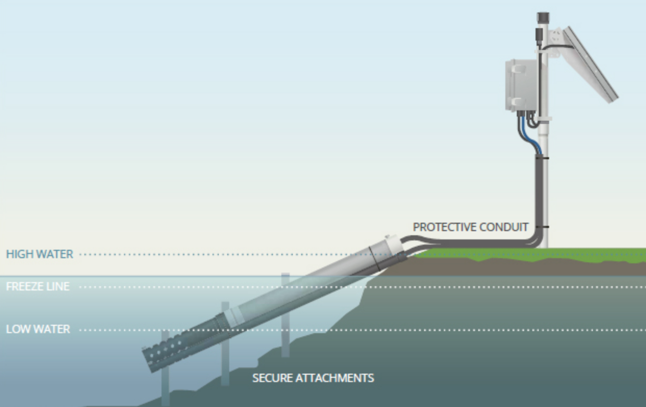
Disadvantages
Installation
Installation
Radar / Ultrasonic
Floating Sensors
Radar / Ultrasonic
Pressure Transducer
https://images.app.goo.gl/BCXCrE2bhJmRC35i8
https://www.hydrospan.cn/en/287.html
https://images.app.goo.gl/rVCjUU56eQgngfM7A
2. Cost
3. Obstruction

Slide 4
Propose Project:
Low-Cost Real-Time Water Depth Measurement System Using a Camera
Benefits:
Less sophisticated installation
Visual Monitoring on the Surroundings
Low-Cost and Real-Time

Slide 5
Literature Review

Slide 6
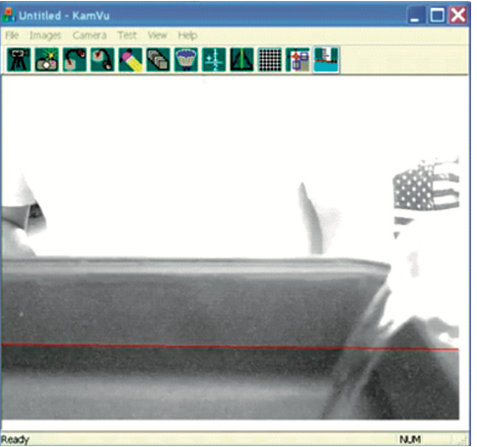
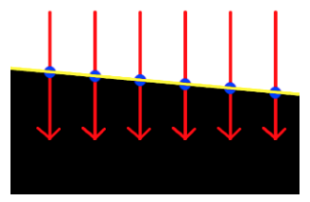
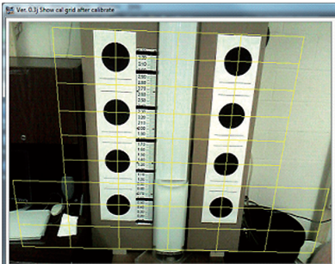
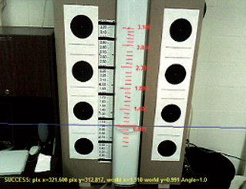
Algorithm: Line-Based Edge Detection
Series of vertical lines
Linear Regression Fit of the edge points
Calibration Fiducials (Large Black Dots to the left and right of the water tube)
Calculated scale from the model
https://www.theimagingsource.com/media/blog/archive/20110908/
Notes:
In this method, a line based edge detection algorithm is used to find the water edge in the tube.
1 A series of vertical lines in the area inside the tube are evaluated to determine the position of the water edge.
The edge point positions are defined by their pixel row and column positions within the image.
2. The equation for the water line is calculated by a linear regression fit of the edge points. THE ACTUAL CODE WAS NOT DISCUSSED IN THE LITERATURE
3. The next step in the process is to Convert the position of the line from the measurement system used in images (pixel units) to world units (feet/meters) by using a calibration fiducials which are the large black dots to the left and right of the water tube. Blob (Binary Large OB) analysis was used to evaluate the image of the scene so that the exact position is known in pixel units.
NOTE: blob detection methods are aimed at detecting regions in a digital image that differ in properties, such as brightness or color, compared to surrounding regions

Slide 7
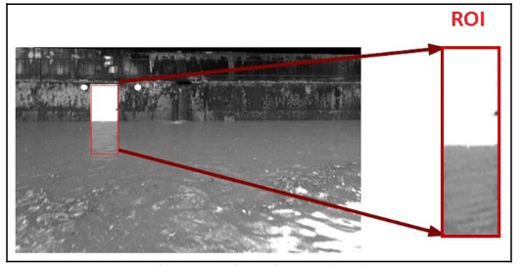
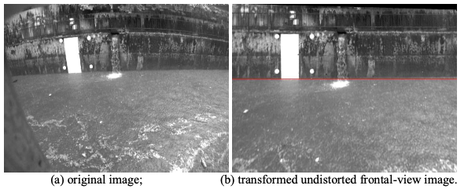
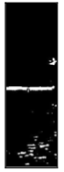
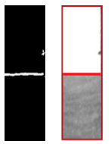
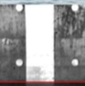
Algorithm: ROI Region of Interest
Undistorted Frontal-View
ROI (Region of Interest)
Edge Detection
Hough-Transformation
Four White Circles in ROI for calibration and references of water depth calculation
Images from Hies, T., Parasuraman, S., Wang, Y., Duester, R., Eikaas, H., & Tan, K. (2012). Enhanced water-level detection by image processing. Paper presented at the 10th International Conference on Hydroinformatics.
Notes:
The 3 major steps for the robust detection of the water level are summarized below:
- Automatic, adaptive selection of the region-of-interest (ROI)
- Edge-detection assuming discontinuities of intensities of pixels of images are linked to
physical changes
- Hough-transformation calculating the longest straight line

Slide 8
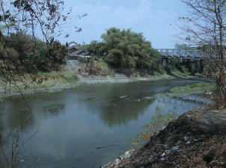
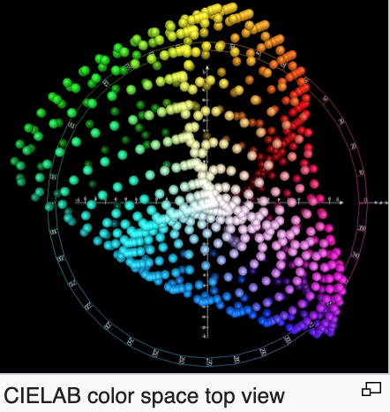
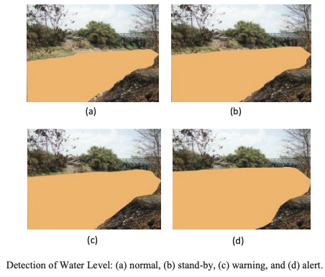
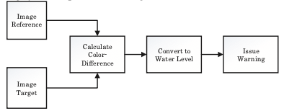
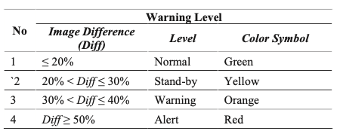
Algorithm: Colour Difference
CIELAB SPACE
Euclidean distance
3. Warning System
https://en.wikipedia.org/wiki/CIELAB_color_space
Images from Purnomo, F. A., Yoeseph, N. M., Riasti, B. K., & Anggara, R. W. (2018). Water level detector for early warning systems using color difference measurement. AIP Conference Proceedings, 1977(1), 050002. doi:10.1063/1.5043006
Notes:
THe color difference formula used is CIELABS. International Commission on Illumination CIE lab
It expresses color as three values: L* for the lightness from black (0) to white (100), a* from green (−) to red (+), and b* from blue (−) to yellow (+)
Color differences were measured in the CIELAB space as the Euclidean distance between the coordinates of the two stimuli.

Slide 9
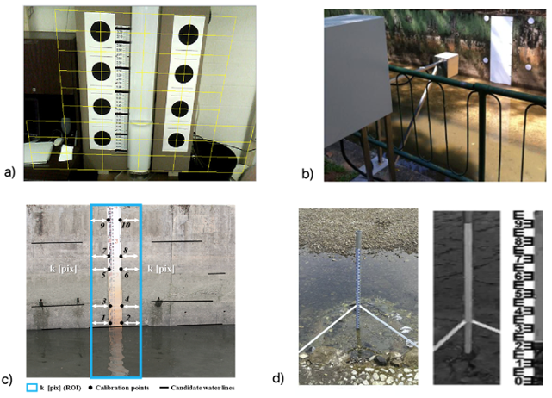
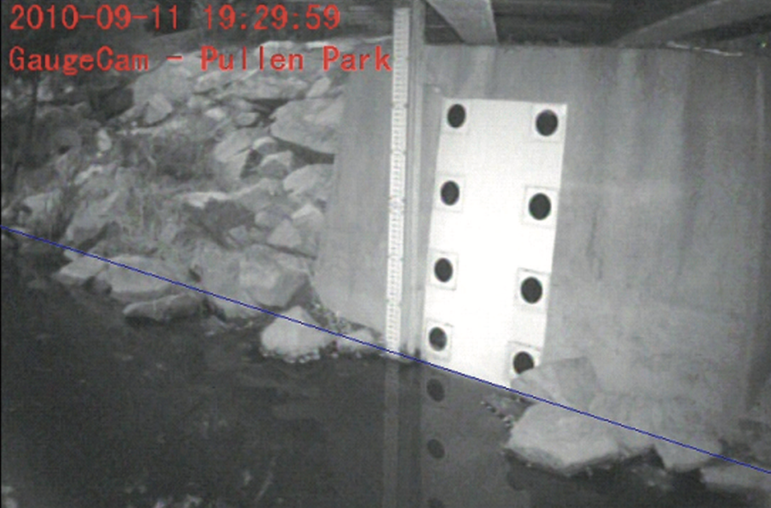
Calibration / Real-World Unit Conversion Used
Large Black Dots
White Circles
Calibration Points
Staff Gauge
Notes:
To convert the position of the line from the water-level measurement system to world units(feet/meters)
As you can see in the pictures, All of them are in contact with the water and basically it should be low tide before they can be installed.
As discussed earlier here are some methods that is used for calibration and convert the image pixel units into world units (feet/meters). However, most of these methods needs to be in contact with the water and basically need to wait for a low tide before they can install them.

Slide 10
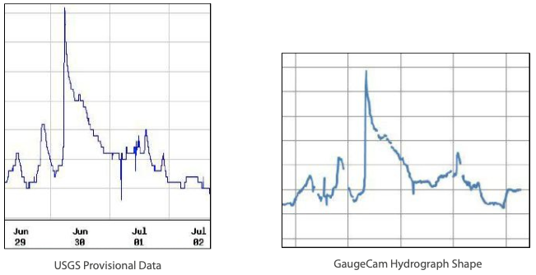
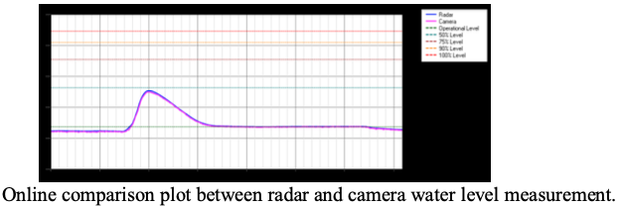
Accuracy
Mirrored data from existing water measurement station
Higher Accuracy and same reliability than conventional sensors
Accuracy depends on the camera resolution
https://www.theimagingsource.com/media/blog/archive/20110908/
Images from Hies, T., Parasuraman, S., Wang, Y.,Duester, R., Eikaas, H., & Tan, K. (2012). Enhanced water-level detection by image processing. Paper presented at the 10th International Conference on Hydroinformatics.

Slide 11
Gaps and Drawbacks
Large Floating object may pass or stuck in the ROI
Noise from heavy rains and other events can have poor result on water line detection.
Limited data connection for High Quality Pictures
Limited visibility during the night.
Notes:
2. Fast current may can become a problem
3. These also includes thick fog
4. Since high resolution cameras can have big data therefore it also need fast data connection.
5. Especially for those system that doesn’t have night visions or infrared

Slide 12
Project Objectives
Develop an Image Processing Algorithm to detect the water depth/level from the image captured by the camera
Low-Cost
Real-Time Measurement Monitoring
Project Question
How to develop a low-cost real-time water depth measurement system using a camera with easy and convenient calibration process?
Notes:
2. Fast current may can become a problem
3. These also includes thick fog
4. Since high resolution cameras can have big data therefore it also need fast data connection.
5. Especially for those system that doesn’t have night visions or infrared

Slide 13
Project Methodology

Slide 14
Proposed Method
Stage 1
Image Processing Algorithm Development
Stage 2
Room / lab experiment of the Algorithm
Stage 3
Field Experiment and Implementation
Deliverable 4

Slide 15
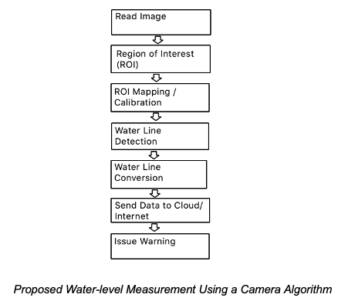
Data Collection Algorithm
Python
OpenCV (Open Source Computer Vision Library)

Slide 16
ROI Mapping / Calibration
Calibration Markings
Detect the Value (Distance from Markings to the bottom of the lake)
Automatic Scaled ROI
Notes:
- The camera is position at the side of the water channel facing the markings for calibration purpose.
- The algorithm should be able to calibrate the depth of the water channel from the other side to the bottom and perform a water level detection and measurement.
- The Microcontroller and power supply casing are placed near and below the camera. The pressure transducer is placed at the bottom of the water channel connected to the microcontroller and power supply cases using a PVC pipe.
- The Camera is connected to a microcontroller where the image processing takes place to measure the water level using the image of the camera.
- The measurement or data is then sent to the Cloud server using LoRawan communication and then can be accessed in the application where the warning system takes place.
- Other means of data communication like WIFI and cellular may be used if available and preferable. Finally, a warning system may be implemented when a certain water level is achieved.

Slide 17
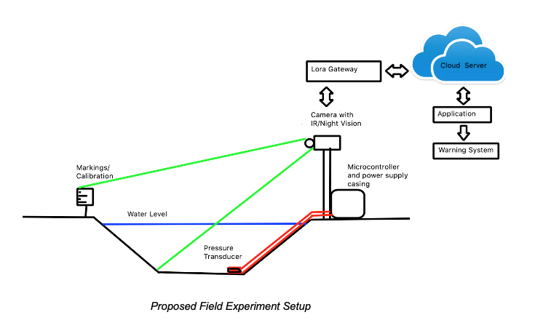
Proposed Field System Setup
Camera Position
Markings / Calibration
System Devices Casing
Communication System
Pressure Transducer
Notes:
- The camera is position at the side of the water channel facing the markings for calibration purpose.
- The algorithm should be able to calibrate the depth of the water channel from the other side to the bottom and perform a water level detection and measurement.
- The Microcontroller and power supply casing are placed near and below the camera. The pressure transducer is placed at the bottom of the water channel connected to the microcontroller and power supply cases using a PVC pipe.
- The Camera is connected to a microcontroller where the image processing takes place to measure the water level using the image of the camera.
- The measurement or data is then sent to the Cloud server using LoRawan communication and then can be accessed in the application where the warning system takes place.
- Other means of data communication like WIFI and cellular may be used if available and preferable. Finally, a warning system may be implemented when a certain water level is achieved.

Slide 18
Gantt Chart

Slide 19
Thank you! Questions?

